Slide 1
Today’s Objectives
Recap
Objects
Constructors
Classes
Test

Slide 2
Objected Oriented Programming
Object-oriented programming (OOP) is a programming paradigm, which uses objects and their interactions for building computer programs.

Slide 3
Characteristics of Objects:
- States – these are the characteristics of the object which define it in a way and describe it in general or in a specific moment
- Behavior – these are the specific distinctive actions, which can be done by the object
- Data members – embedded in objects variables, which describe their states.
- Methods – we have already considered them in details. They are a tool for building the objects.

Slide 4

Object Example
Let’s take for example an object from the real world – "dog". The states of the dog can be "name", "fur color" and "breed", and its behavior – "barking", "sitting" and "walking".

Slide 5
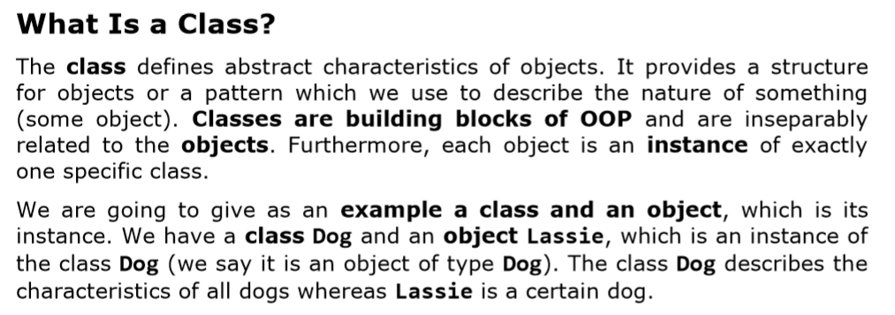

Slide 6
What Are Classes in C#?
A class in C# is defined by the keyword class, followed by an identifier (name) of the class and a set of data members and methods in a separate code block.
Classes in C# can contain the following elements:
Fields – member-variables from a certain type;
Properties – these are a special type of elements, which extend the functionality of the fields by giving the ability of extra data management when extracting and recording it in the class fields
Methods – they implement the manipulation of the data.

Slide 7
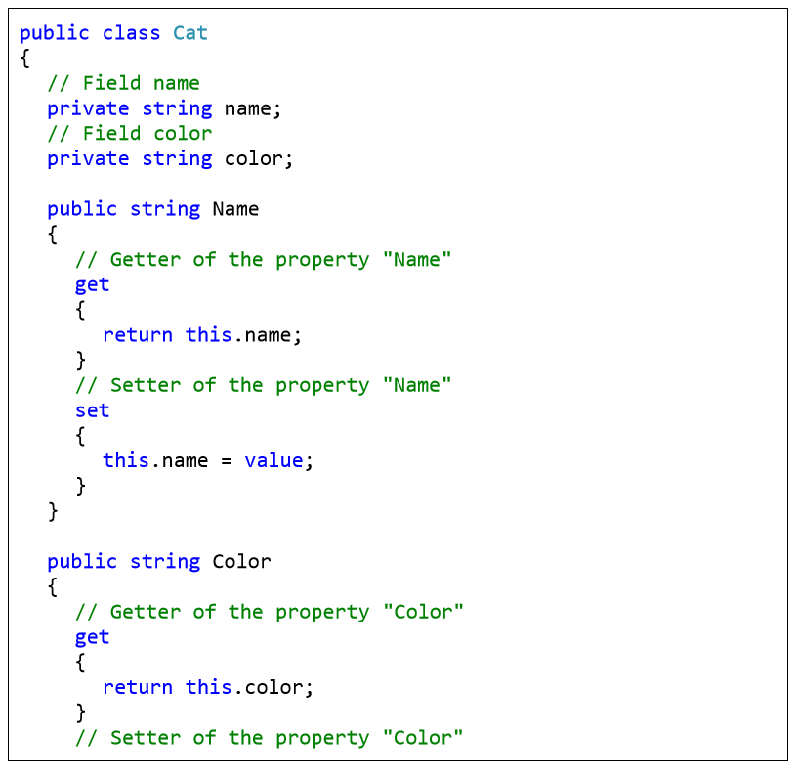

Slide 8
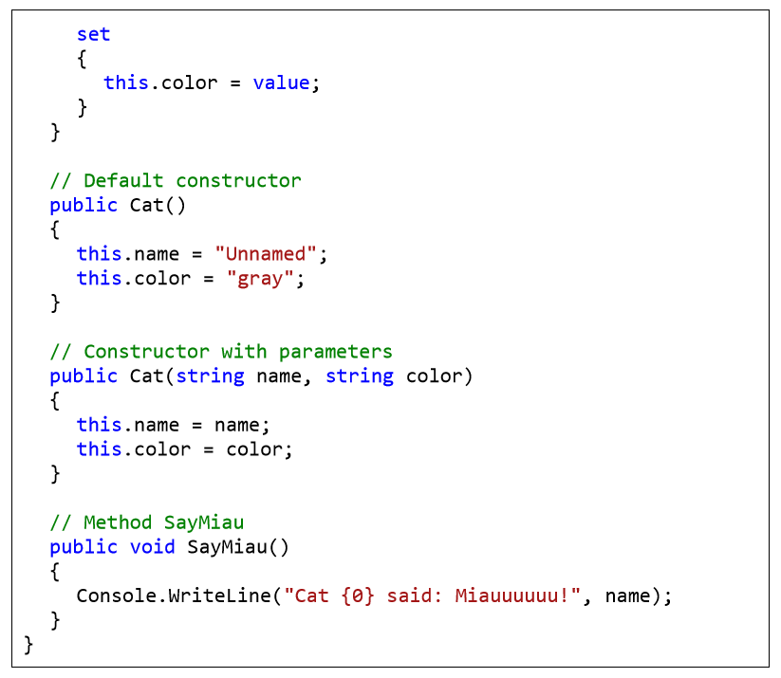

Slide 9
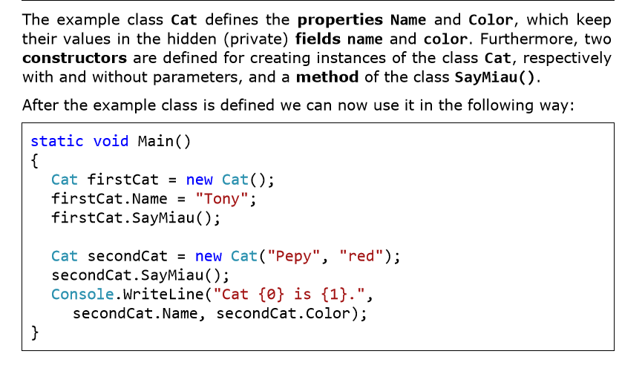

Slide 10
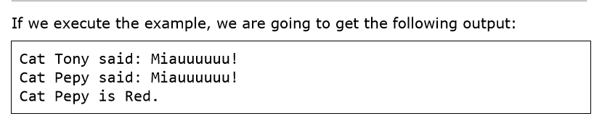

Slide 11
Creating and Using Objects

Slide 12
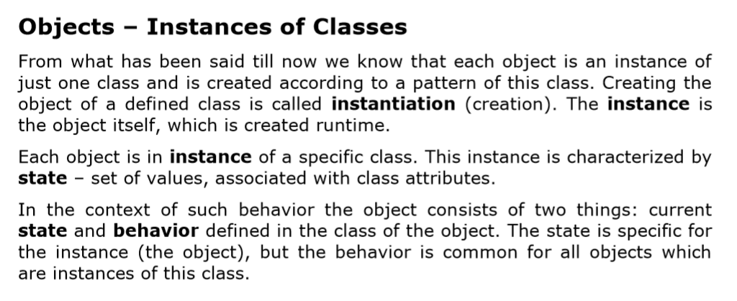

Slide 13
Creating and Releasing Objects
The creation of objects from preliminarily defined classes during program execution is performed by the operator new. The newly created object is usually assigned to the variable from type coinciding with the class of the Object.
We are going to note that in this assignment the object is not copied, and only a reference to the newly created object is recorded in the variable (its address in the memory). Here is a simple example of how it works:

Slide 14
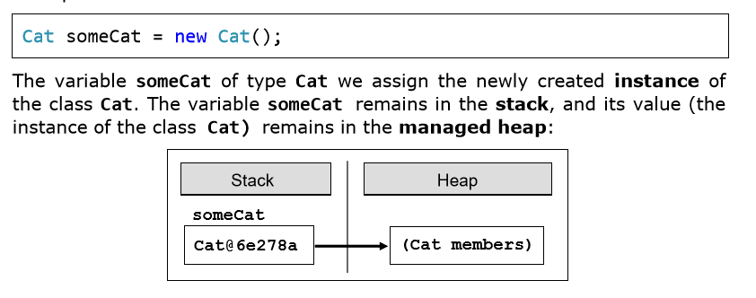

Slide 15
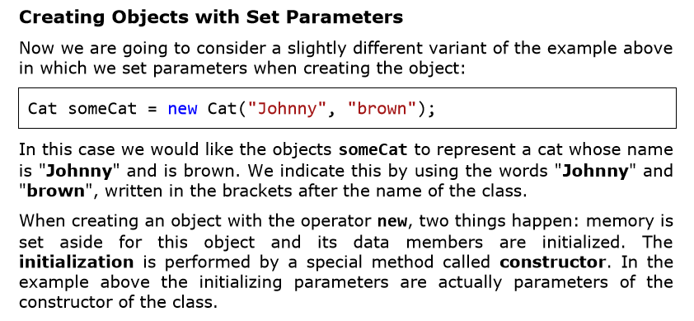

Slide 16
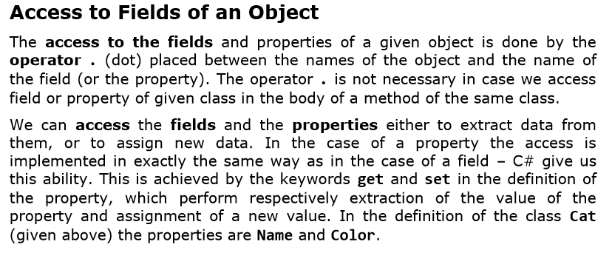

Slide 17
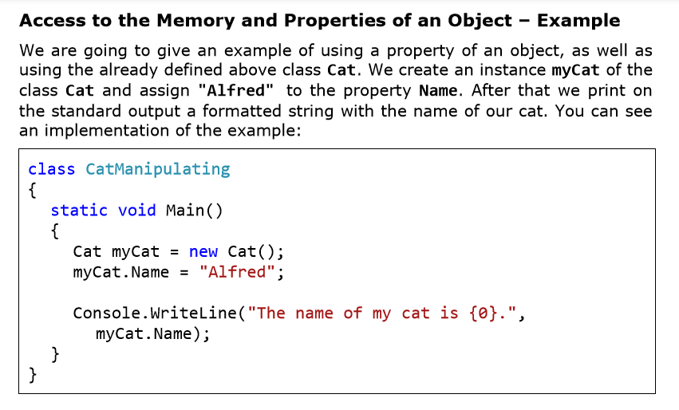

Slide 18
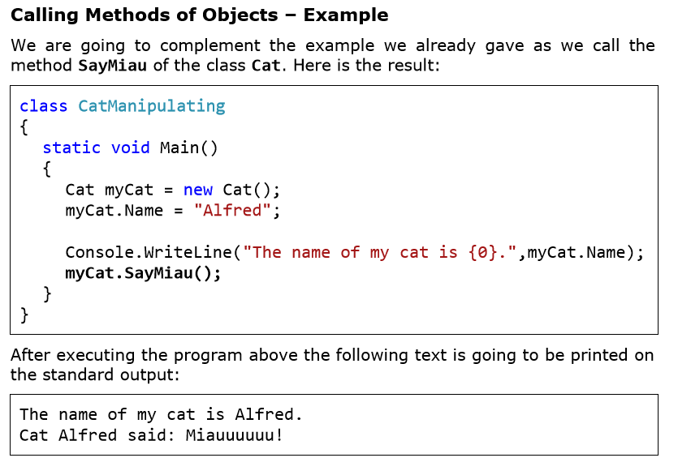

Slide 19
Constructors

Slide 20
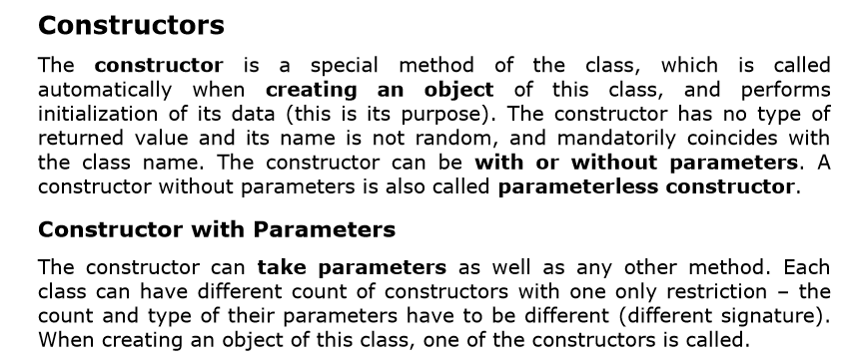

Slide 21
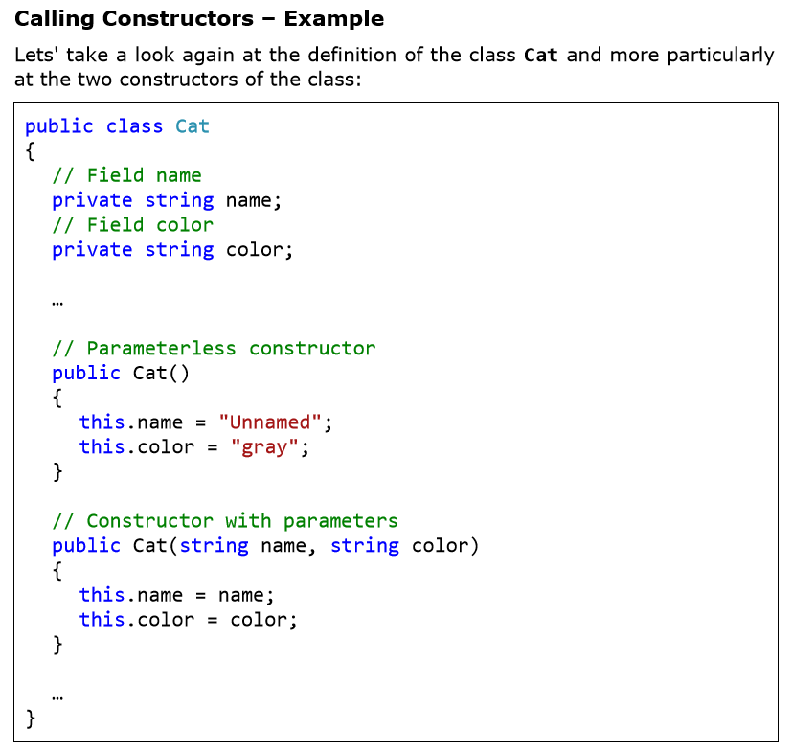

Slide 22
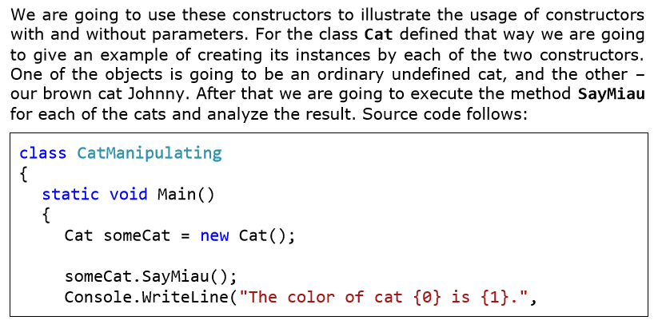

Slide 23
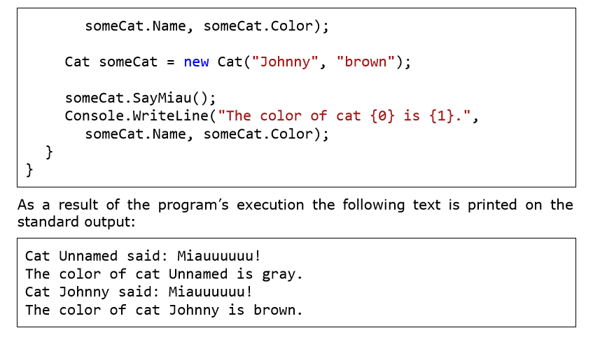

Slide 24
The end
Ooko Emmanuel

